Slide 1
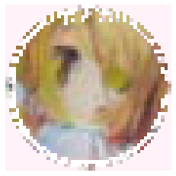
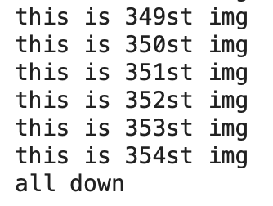
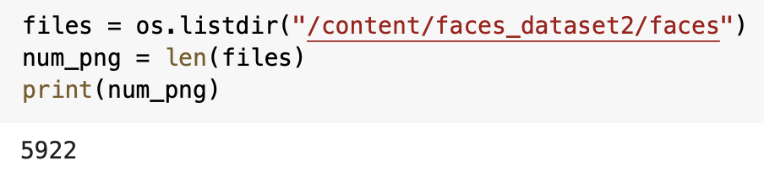
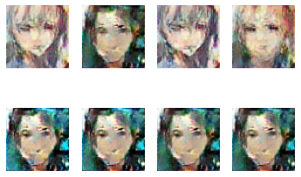
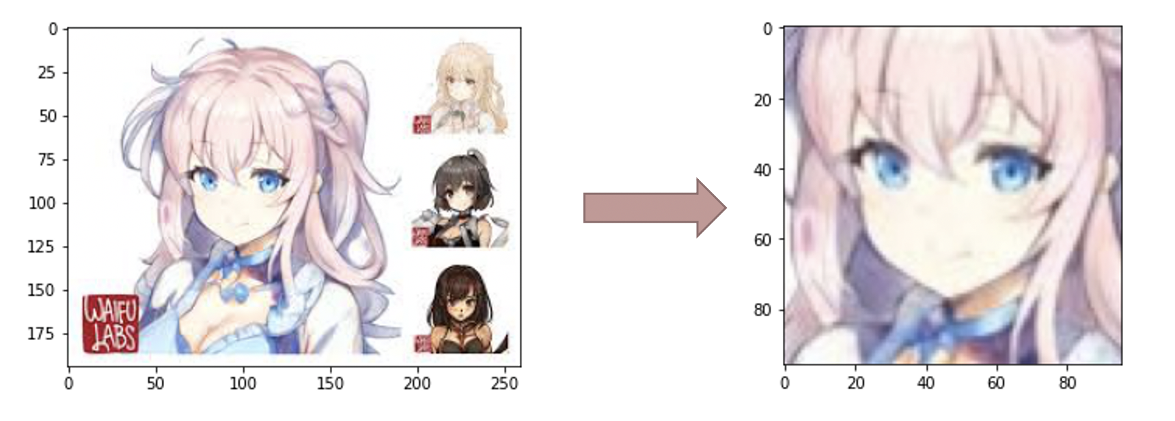
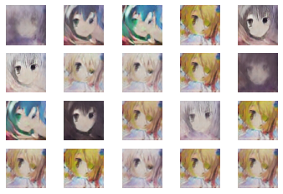

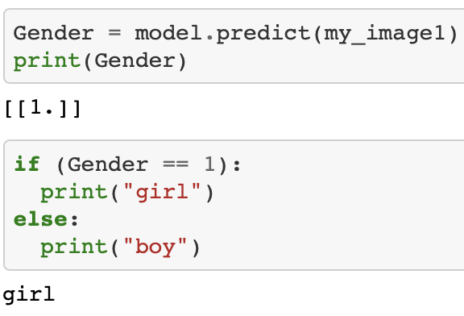

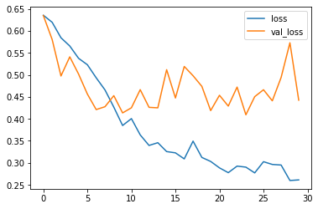
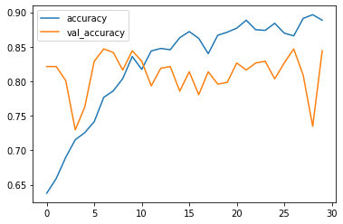
Anime Avatars Generation And Classification
Team Member: Yueqi Pan, Siyu Fang
George Washington University
Code link: https://github.com/YueqiPan/Final.git - with 3 parts
Structure
Introduction
Web Crawling
Crop images
Generate images
Gender
Classification
Adding
Avatar frame
This project, we can divide into five parts ：
Web crawling around 6000 anime images from Google to create our dataset
Using the face detector for anime to detect the faces of anime characters and extract faces from images
Generate anime avatars from real anime avatar by using DCGAN(Deep Convolutional Generative Adversarial Networks)
Build a CNN(Convolutional Neural Network) model to classify the gender of anime character avatars
Adding a frame to avatar
Part 1, part 2, part 4, and part 5 are our modifications, and part 3 is directly using the code from website Gluon. The code of part 5 is about how to generate images by using DCGAN. We changed the dataset of the original code to anime characters. We decide to get our dataset by web scraping images from Google. By installing selenium and using selenium to crawl google images, we can download around 350 images per query. In order to get enough images in our dataset, we repeat the process 17 times, and get 5922 images in total.
After creating our dataset, we use cascade file lbpcascade_animeface and OpenCv to detect the faces of anime characters and extract faces from images to create avatars and store these avatars images into files. Then, we want to generate avatars from these avatars images in our datasets by using DCGAN. We preprocess our dataset, build generator and discriminator, setup loss function and optimizer, train the model with epochs=30, and generate some images of anime faces.
Some web users prefer to use girls’ avatars and some users prefer to use boys’ avatars. Since we have generated avatars images, we would like to classify the gender of these anime characters. CNN are primarily used to classify images, so we create a CNN to classify the gender of our generated avatar. After we identify the gender of our generated avatar, we would like to add frames to make our avatar more unique and fancy. We use Numpy and OpenCv to give our avatar added a cute frame.
5. Adding a frame to our generated avatar
Result
The results of our project can be displayed in five parts:
Web crawling 5922 anime images from Google
We can crawl and download around 350 images each time, we repeat the process and download 5922 images into our file folder faces.
Using the face detector for anime to detect the faces of anime characters and extract faces from images:
Generate anime avatars from real anime avatar images by using DCGAN
There are 20 images that we generate after we run 30 epochs:
Build a CNN model to classify the gender of our generated anime character avatar
The accuracy is high. It’s around 90% accurate of our model’s prediction after 30 epochs. The accuracy of validation is not very stable, it goes up and down around 80%, which is good. The loss is decreasing, it means errors are decreasing. The overall trend of loss of validation is also decreasing.
CONCLUSION
From the result of our generated image in the DCGAN step, we can see the result good, but not perfect. We first tried to increase the epochs to let epochs=100. And this is the result we get:
We can see the faces are blurred and distorted.
So, we analyzed it carefully and figured out some reasons that our results are not good enough as:
The style/type of anime characters faces are not consistent. The generator may not able to deal with many different styles of faces very well.
We only crawl around 350 images per query. And by repeat doing 17 times, the pictures may repeated or not relevant. And we only have 5922 images in our dataset, it may not enough for us to train the model
The Deep Convolution Network loss gradient when epochs are bigger. Choose other network, such as Resnet, may solve the gradient explosion problem.
The result of CNN model is quite good. The accuracy after 30 epochs is around 90%, it means the accuracy of using the model to predict the gender is high. And the loss is low after 30 epochs, it means the model behaved very well.
OBJECTIVE
Instead of downloading dataset or use other’s dataset, we would like to try to create our dataset by web crawling images from Google
Tring to use OpenCv to extract faces from images and create a new dataset
Using DCGAN to generate new images
Using CNN to do classification and see the model accuracy
Adding image to an image
Analysis our problems
METHODS
1. Web Crawling from Google: Using Selenium
Selenium is able to stimulate human’s actions. We pair up Selenium with Google Chrome and automate it to get the images we want.
2. Detect face and extract face from image: Using cascade file lbpcascade_animeface and CV2.CascadeClassifier
lbpcascade_animeface is a face detector for anime/manga Using OpenCv. And Cascade Classifier is an effective object detection method proposed by Paul Viola and Michael Jones in their paper, “Rapid Object Detection using a Boosted Cascade of Simple Features” in 2001. We use Glob to get a list of files with matching filenames and store these files.
3. Generate images: DCGAN
We use mxnet-cu100 framework and mxnet.gulon to maximize the efficiency and make it easier to build and train model. The size of images are different, we resize the images to 64*64. Then, we normalize all pixel values to the [−1,1] range. We use epochs=30, batch size=64, size of latent space=100, and learning rate=0.0002. We set the input section nz,ngf, and nc for the generator, and processes images through a series of Conv2d, BatchNorm2d, and LeakyReLU layers in the discriminator. We use binary cross-entropy as our loss function and use the Adam optimizer. We use GPU to train the model and display 20 generated images.
4. Classify gender: CNN
We use 2636 gender classified images as our training set, we split 85% of them to be our training data and 15% of them to be our validation data. We run epochs=30 to train the model.
5. Add frame: Numpy And OpenCv
REFERENCES
1. The original code of DCGAN:
https://gluon.mxnet.io/chapter14_generative-adversarial-networks/dcgan.html#Set-training-parameters
2. nagadomi/lbcascade_animeface
https://github.com/nagadomi/lbpcascade_animeface
3. Idea source: Chainerで顔イラストの自動生成
https://qiita.com/mattya/items/e5bfe5e04b9d2f0bbd47

